Slide 1
Agenda (morning)
[9:00-9:20] Survey
[9:20-9:40] Intro and lab 00
[9:40-9:50] Break
[9:50-11:00] Neural network principles
[11:00-11:10] Break
[11:10am-12:00] Lab 01&02
[12:00-1:00 pm] Lunch break

Slide 2
Agenda (afternoon)
[1:00-1:20] Convolutional neural network
[1:20-1:40] Lab 03&break
[1:40-2:00] Data augmentation and transfer learning
[2:00-2:30] Lab 04&05&break
[2:30-3:30] Generative AI, tokenization, and embedding
[3:30-4:00] Lab 06&break
[4:00-4:20] Survey
[4:20-5:00] Final exam lab 07 or leave early

Slide 3


Slide 4
NVIDIA resources
https://learn.nvidia.com/dli-event
Event code: TAMU_FDL_AMBASSADOR_JULY25

Slide 5
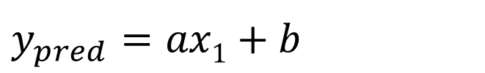
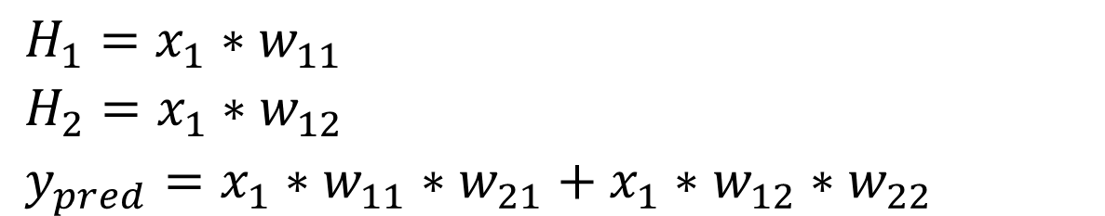
y
$y_{pred}$ $=ax1+b$
H₁
30
w₁₁
w₂₁
x₁
y
20
w₂₂
w₁₂
H₂
10
0
1
2
5
x
$H_{1}=x_{1}∗w_{11}$
$H_{2}=x_{1}∗w_{12}$
$y_{pred}=x_{1}∗w_{11}∗w_{21}+x_{1}∗w_{12}∗w_{22}$
x | y
1 | 10
2 | 20
5 | 30

Slide 6
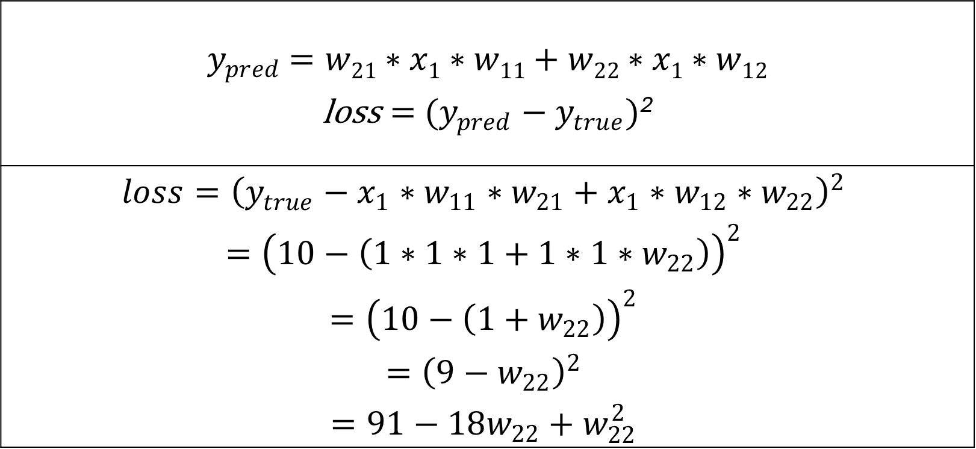
$y_{pred}$ $=w21∗x1∗w11+w22∗x1∗w12$ $\text{loss}={ (y_{pred}−y}_{true})$²
$$loss={\left(y_{true}−x_{1}∗w_{11}∗w_{21}+x_{1}∗w_{12}∗w_{22}\right)}^{2}$$ $$={\left(10−\left(1∗1∗1+1∗1∗w_{22}\right)\right)}^{2}$$ $$={\left(10−\left({1+w}_{22}\right)\right)}^{2}$$ $$={\left(9−w_{22}\right)}^{2}$$ $$=91−18w_{22}+w_{22}^{2}$$
x | y
1 | 10
2 | 20
5 | 30

Slide 7
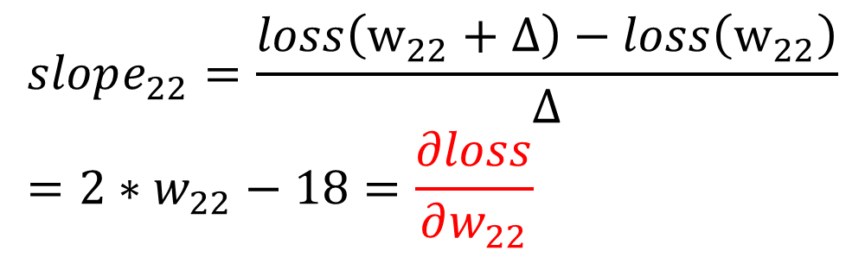
H₁
Loss
w₁₁
w₂₁
x₁
y
w₂₂
w₁₂
H₂
Slope: -
Slope: +
0
9
w₂₂
$$loss=91−18w_{22}+w_{22}^{2}$$
x | y
1 | 10
2 | 20
5 | 30
$$slope_{22}=\frac{loss\left(w_{22}+Δ\right)−loss\left(w_{22}\right)}{Δ}=2∗w_{22}−18=\frac{∂loss}{∂w_{22}}$$

Slide 8
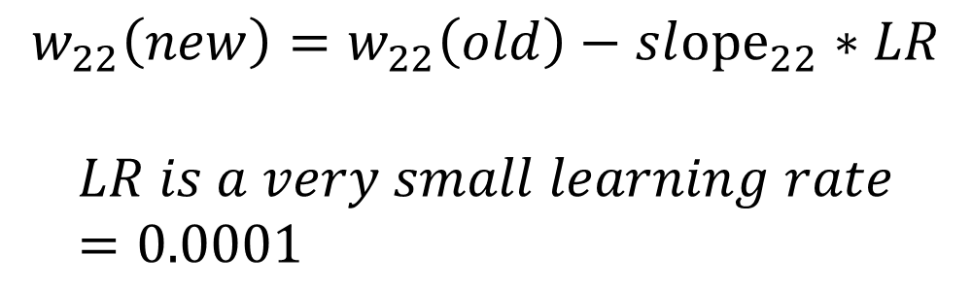
H₁
Loss
w₁₁
w₂₁
x₁
y
w₂₂
w₁₂
H₂
Slope: -
Slope: +
0
9
w₂₂
x | y
1 | 10
2 | 20
5 | 30
$$w_{22}\left(new\right)=w_{22}\left(old\right)−sl{ope}_{22}∗LR$$
$$LR is a very small learning rate=0.0001$$

Slide 9
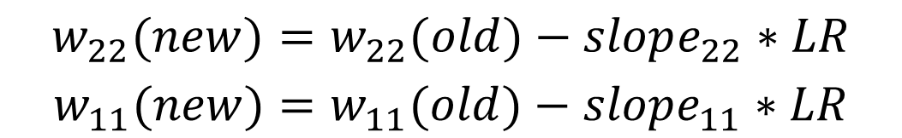
H₁
Loss
w₁₁
w₂₁
x₁
y
w₂₂
w₁₂
H₂
0
w₂₂
w₁₁
$$w_{22}(new)=w_{22}(old)−slope_{22}∗LR$$
$$w_{11}(new)=w_{11}(old)−slope_{11}∗LR$$
x | y
1 | 10
2 | 20
5 | 30

Slide 10

$$w_{22}(new)=w_{22}(old)−slope_{22}∗LR$$
$$w_{11}(new)=w_{11}(old)−slope_{11}∗LR$$
$$w_{12}(new)=w_{12}(old)−slope_{12}∗LR$$
$$w_{21}(new)=w_{21}(old)−slope_{21}∗LR$$
Loss
H₁
w₁₁
w₂₁
x₁
y
w₂₂
w₁₂
H₂
0
w₂₂
w₁₁

Slide 11
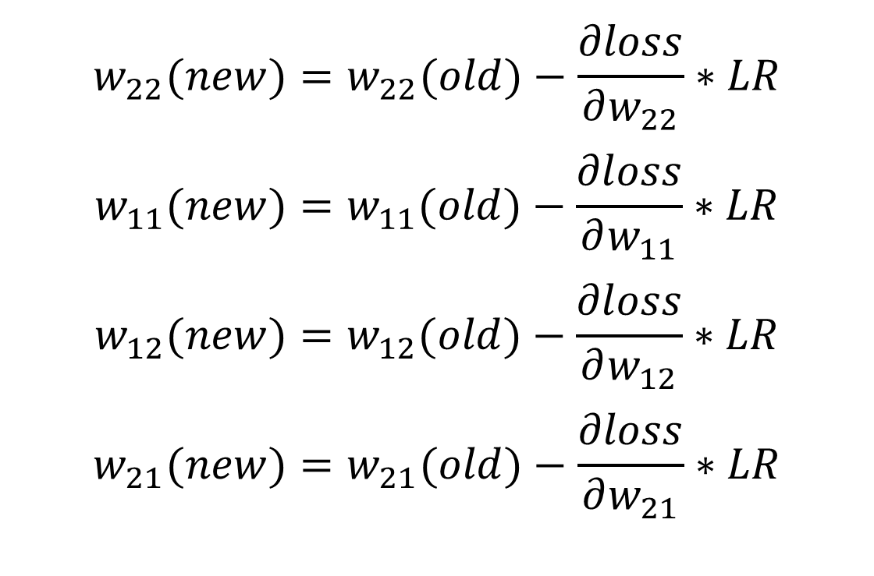
H₁
w₁₁
w₂₁
x₁
y
w₂₂
w₁₂
H₂
$$w_{22}(new)=w_{22}(old)−\frac{∂loss}{∂w_{22}}∗LR$$
$$w_{11}(new)=w_{11}(old)−\frac{∂loss}{∂w_{11}}∗LR$$
$$w_{12}(new)=w_{12}(old)−\frac{∂loss}{∂w_{12}}∗LR$$
$$w_{21}(new)=w_{21}(old)−\frac{∂loss}{∂w_{21}}∗LR$$

Slide 12
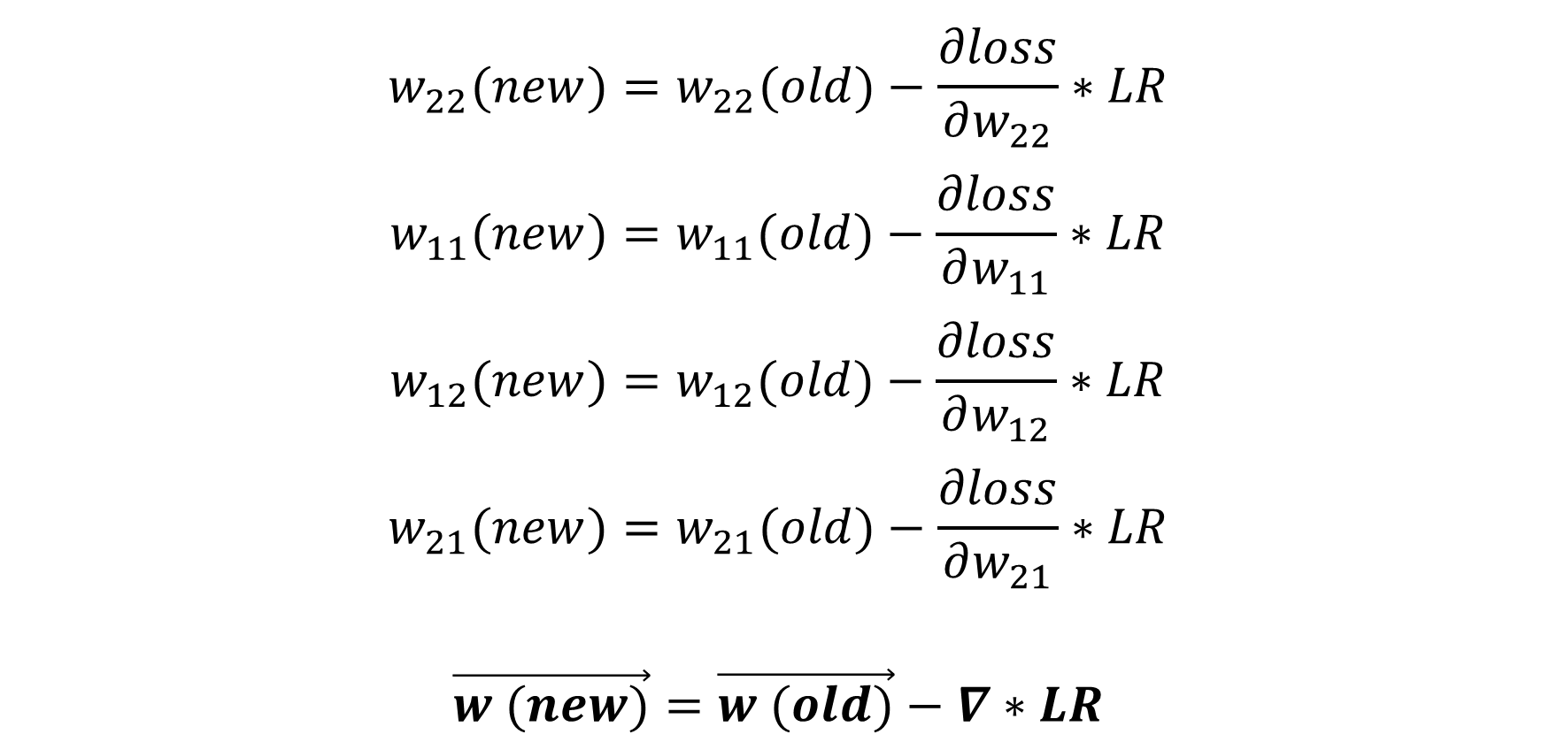
$$w_{22}(new)=w_{22}(old)−\frac{∂loss}{∂w_{22}}∗LR$$
$$w_{11}(new)=w_{11}(old)−\frac{∂loss}{∂w_{11}}∗LR$$
$$w_{12}(new)=w_{12}(old)−\frac{∂loss}{∂w_{12}}∗LR$$
$$w_{21}(new)=w_{21}(old)−\frac{∂loss}{∂w_{21}}∗LR$$
$$\vec{w (new)}=\vec{w (old)}−∇∗LR$$

Slide 13
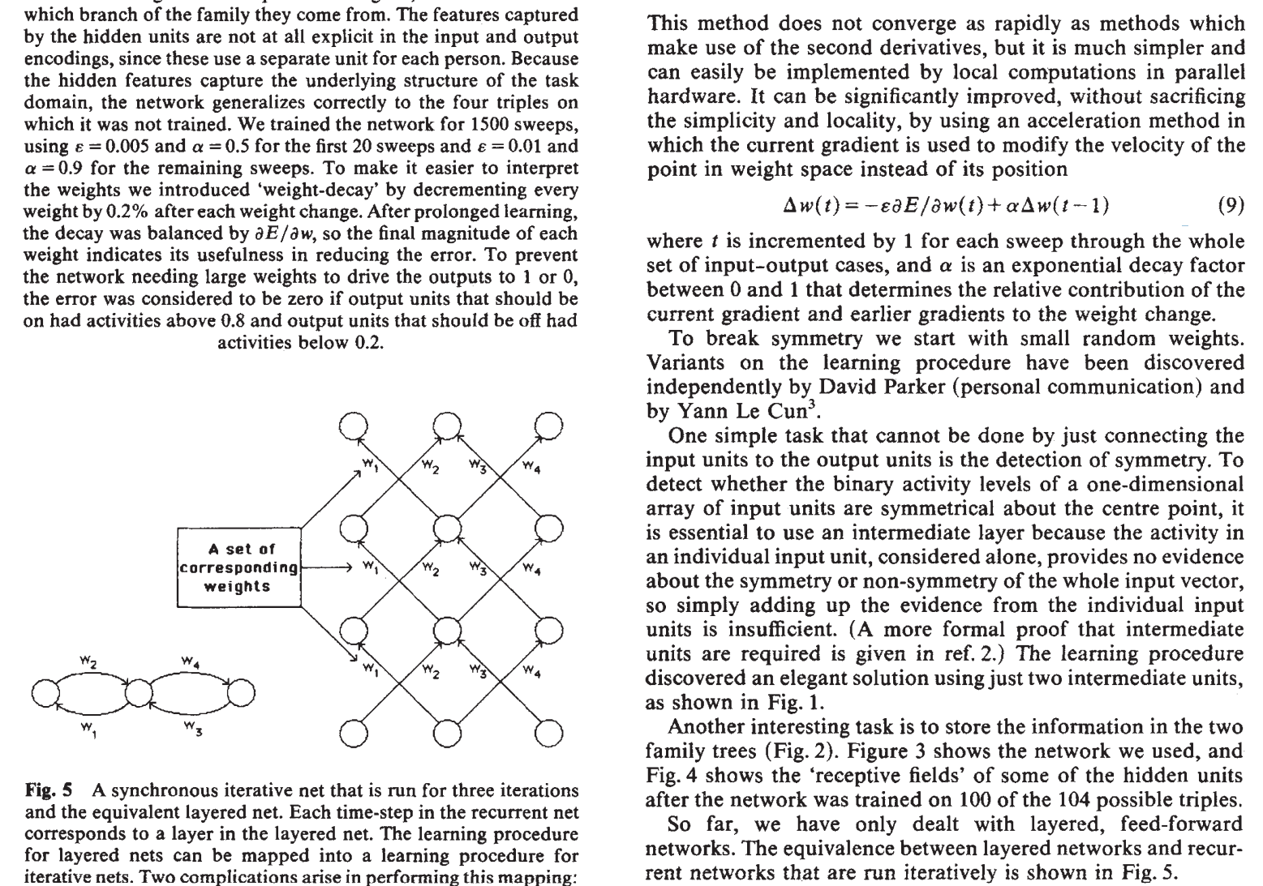
Rumelhart, D. E., Hinton, G. E., & Williams, R. J. (1986). Learning representations by back-propagating errors. nature, 323(6088), 533-536.

Slide 14
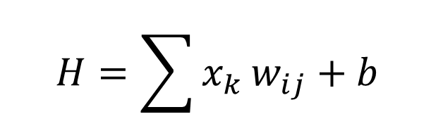
H₁
H
W₂₁
W₁₁
For each neuron H:
x₁
H₂
W₂₂
W₁₂
$$H=\sum{x_{k}}w_{ij}+b$$
y₁
x₂
y₂
w_{ij} is the weight
b is the bias
A DNN has millions of weights and biases
W_{ij}
H_{k}

Slide 15
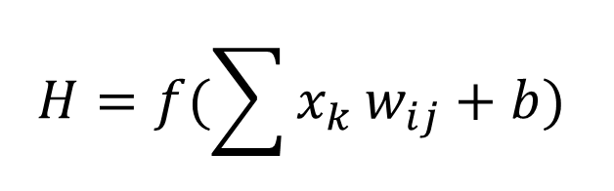
H₁
H
W₂₁
W₁₁
For each neuron H:
x₁
H₂
W₂₂
W₁₂
$$H=f(\sum{x_{k}}w_{ij}+b)$$
y₁
x₂
y₂
f is the activation function
w_{ij} is the weight
b is the bias
A DNN has millions of weights and biases
W_{ij}
H_{k}

Slide 16
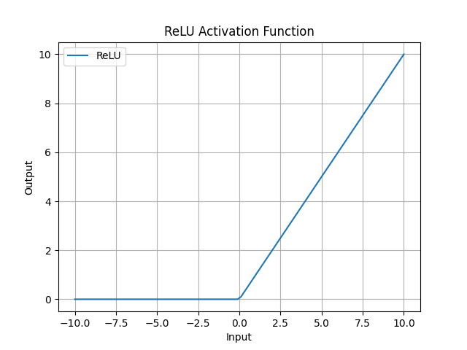

Slide 17
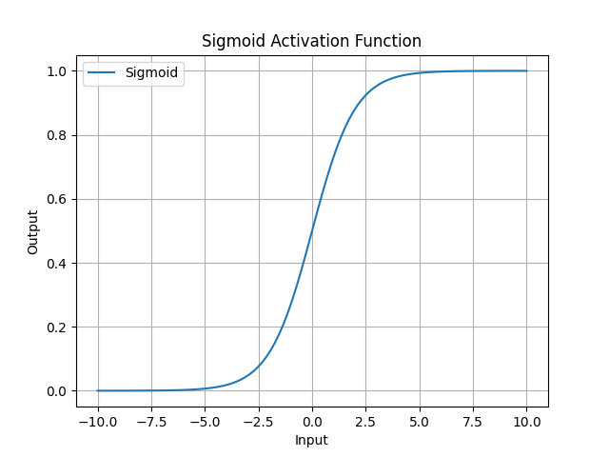

Slide 18
Output types
Regression
Classification
Feature extraction
Combination

Slide 19
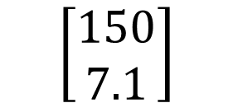
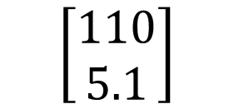
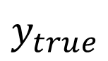
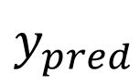
H₁
H
W₂₁
W₁₁
x₁
H₂
W₂₂
W₁₂
y₁
Weight (lbs)
$y_{pred}$
$y_{true}$
x₂
$$\left[\begin{aligned}110 \\ 5.1\end{aligned}\right]$$
$$\left[\begin{aligned}150 \\ 7.1\end{aligned}\right]$$
y₂
Height (feet)
W_{ij}
H_{k}

Slide 20
Regression loss
Mean absolute error
Mean square error
$$MAE=\frac{1}{n}|y_{pred}−y_{true}|$$
$$MSE=\frac{1}{n}{\left(y_{pred}−y_{true}\right)}^{2}$$

Slide 21
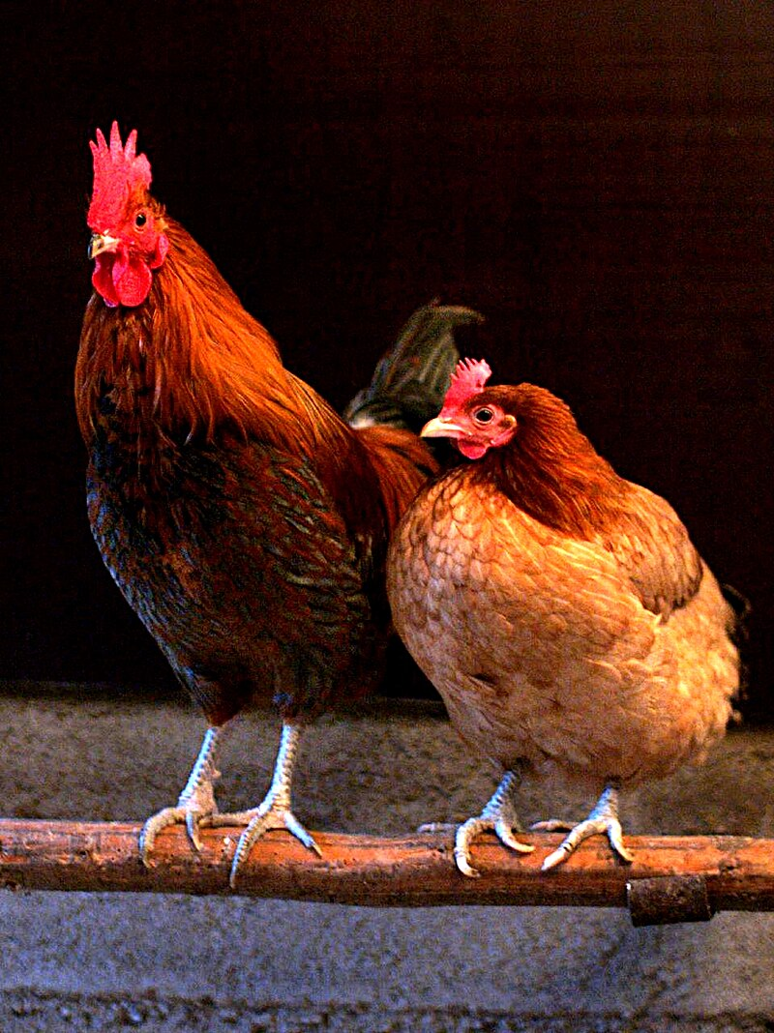
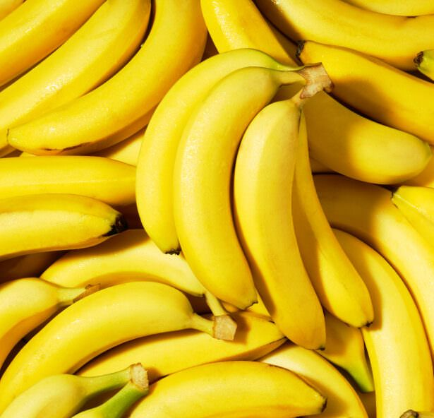
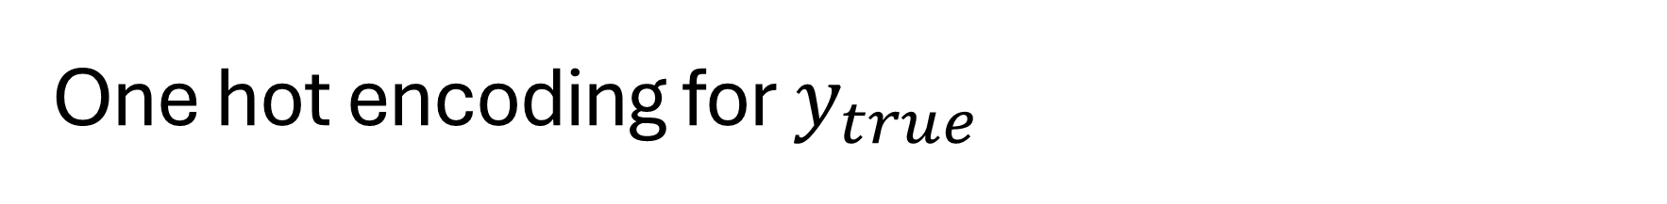
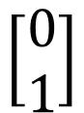
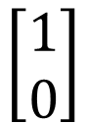
One hot encoding for $y_{true}$
$$\left[\begin{aligned}1 \\ 0\end{aligned}\right]$$
Chicken
Banana
$$\left[\begin{aligned}0 \\ 1\end{aligned}\right]$$

Slide 22

Softmax for y_pred

Slide 23

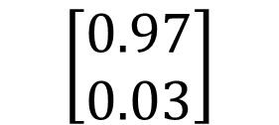
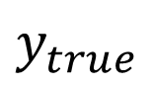
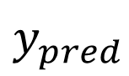
H₁
H
W₂₁
W₁₁
x₁
H₂
W₂₂
W₁₂
y₁
Chicken
$y_{pred}$
$y_{true}$
x₂
$$\left[\begin{aligned}0.97 \\ 0.03\end{aligned}\right]$$
$$\left[\begin{aligned}1 \\ 0\end{aligned}\right]$$
y₂
Banana
W_{ij}
H_{k}

Slide 24
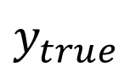
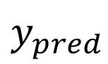
H₁
H
W₂₁
W₁₁
$y_{pred}$
$y_{true}$
x₁
H₂
W₂₂
W₁₂
y₁
Recommend
Engaged
x₂
y₂
Not Recommend
Not Engaged
W_{ij}
H_{k}

Slide 25
Cross entropy loss for classification
Binary cross entropy
After softmax
Multi class entropy
After softmax
$$BCE=−\sum{y_{true}∗\log\left(y_{pred}\right)+\left(1−y_{true}\right)∗log⁡(1−y_{pred})}$$
$$CE=−\sum{y_{true}∗\log\left(y_{pred}\right)}$$

Slide 26
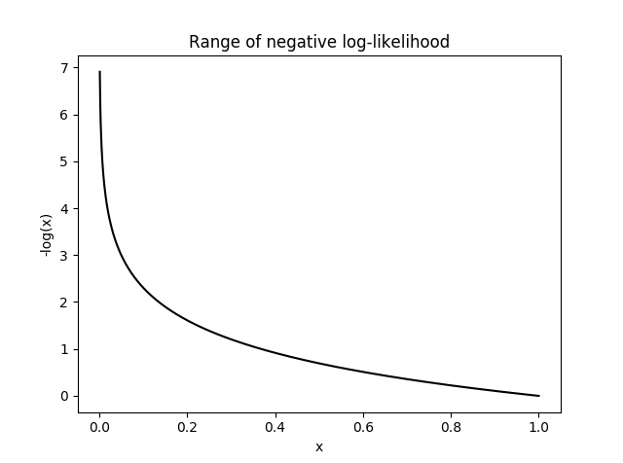

Slide 27
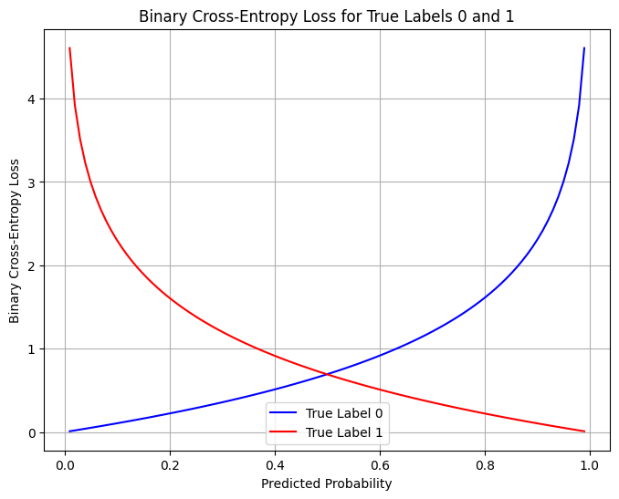

Slide 28

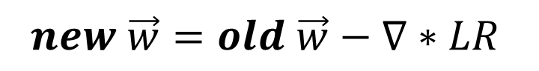
Weight update
H₁
H
W₂₁
W₁₁
x₁
H₂
W₂₂
W₁₂
Learn
Fit
Train
Back propagation
y_{1_true}
y₁
x₂
$$loss$$
y₂
y_{2_true}
W_{ij}
H_{k}
$$new \vec{w}=old \vec{w}−∇∗LR$$

Slide 29

Use the model
H₁
H
W₂₁
W₁₁
x₁
H₂
W₂₂
W₁₂
Forward pass
Inference
Test
Validation
Deployment
y₁
x₂
y₂
W_{ij}
H_{k}
$$NN\left(\vec{x}\right)=\vec{y}$$

Slide 30
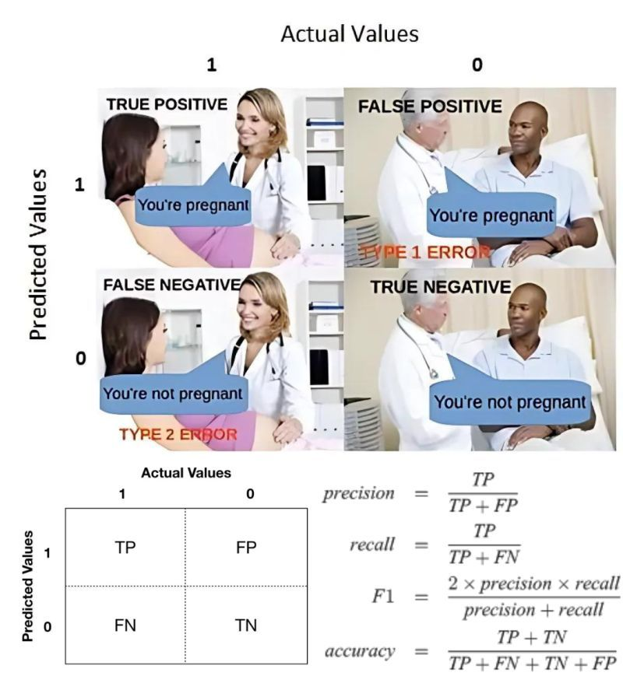
Image Credit: Linkedin.com

Slide 31
Underfitting
Overfitting
Loss
Validation
Training
0
Epoch

Slide 32
Computer vision

Slide 33
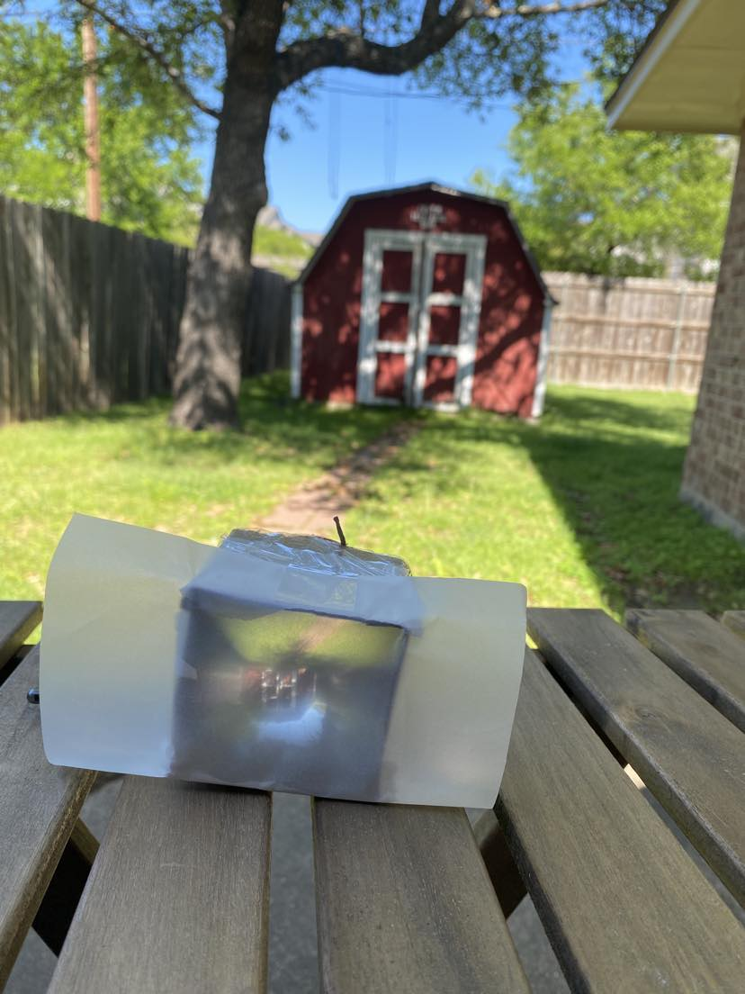
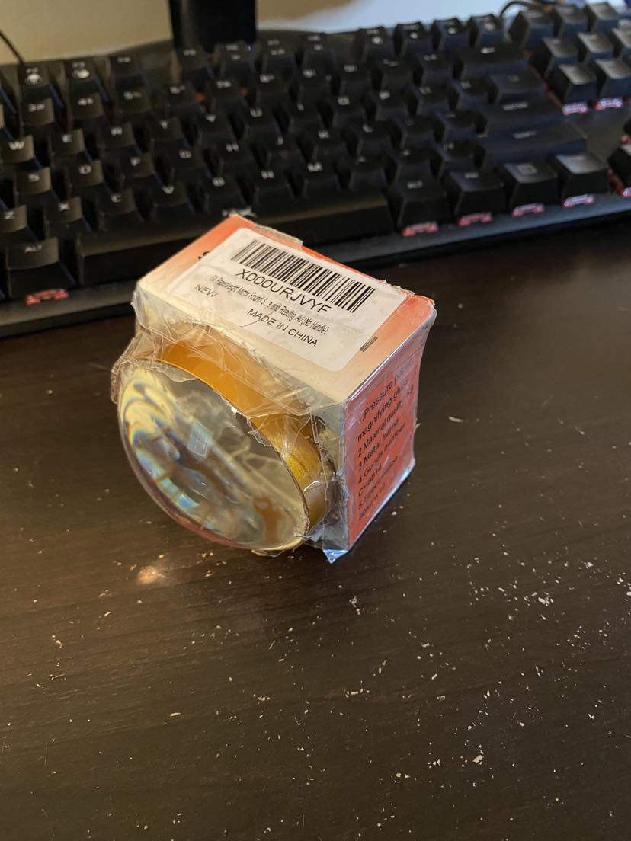

Slide 34
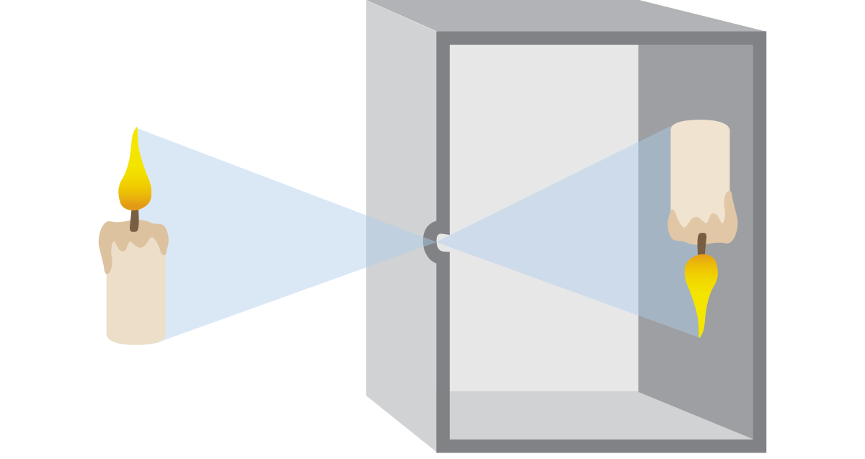
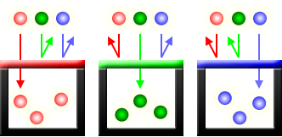
Pinhole principle
Traditional film
Digital sensors (CCD and CMOS)
Red Green Blue (RGB) channels

Slide 35
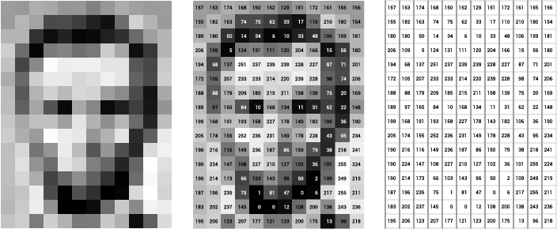
Grey Scale
Image of Abraham Lincoln as a matrix of pixel values. Image Credit: Thomas Smits

Slide 36
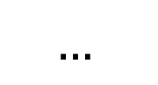
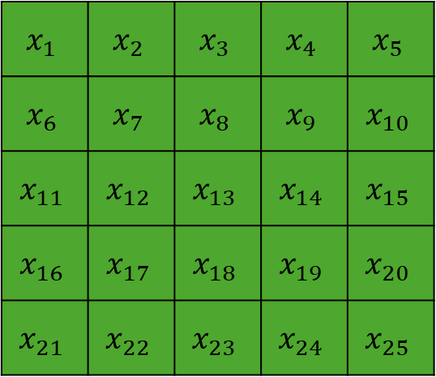
H₁
H
W₂₁
W₁₁
$$x_{1}$$ | $$x_{2}$$ | $$x_{3}$$ | $$x_{4}$$ | $$x_{5}$$
$$x_{6}$$ | $$x_{7}$$ | $$x_{8}$$ | $$x_{9}$$ | $$x_{10}$$
$$x_{11}$$ | $$x_{12}$$ | $$x_{13}$$ | $$x_{14}$$ | $$x_{15}$$
$$x_{16}$$ | $$x_{17}$$ | $$x_{18}$$ | $$x_{19}$$ | $$x_{20}$$
$$x_{21}$$ | $$x_{22}$$ | $$x_{23}$$ | $$x_{24}$$ | $$x_{25}$$
x₁
H₂
W₂₂
W₁₂
y₁
x₂
$$…$$
y₂
W_{ij}
H_{k}

Slide 37
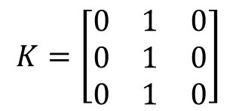
Convolution Computation
7 | 7 | 7 | 7 | 5
7 | 7 | 7 | 5 | 5
7 | 7 | 5 | 5 | 5
7 | 5 | 5 | 5 | 5
5 | 5 | 5 | 5 | 5
7 | 7 | 7 | 7 | 5
7 | 7 | 7 | 5 | 5
7 | 7 | 5 | 5 | 5
7 | 5 | 5 | 5 | 5
5 | 5 | 5 | 5 | 5
7 | 7 | 7 | 7 | 5
7 | 7 | 7 | 5 | 5
7 | 7 | 5 | 5 | 5
7 | 5 | 5 | 5 | 5
5 | 5 | 5 | 5 | 5
$$K=\left[\begin{matrix}0 & 1 & 0 \\ 0 & 1 & 0 \\ 0 & 1 & 0\end{matrix}\right]$$
0 | 0 | 0 | 0 | 0
0 | 21 | 19 | 17 | 0
0 | 19 | 17 | 15 | 0
0 | 17 | 15 | 15 | 0
0 | 0 | 0 | 0 | 0
Kernel at position 1
Kernel at position 2
Kernel at position n

Slide 38
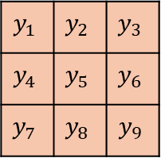
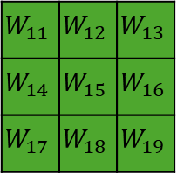
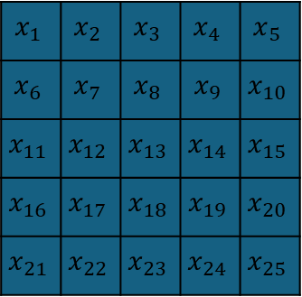
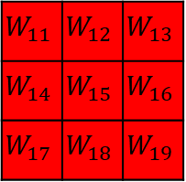
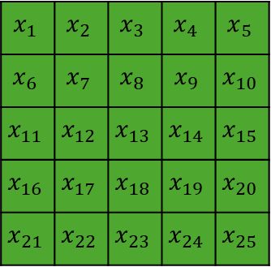
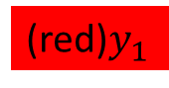
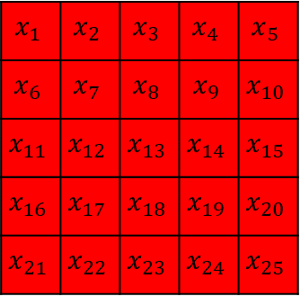
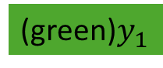
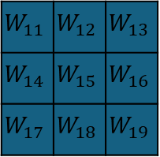
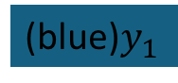
$$x_{1}$$ | $$x_{2}$$ | $$x_{3}$$ | $$x_{4}$$ | $$x_{5}$$
$$x_{6}$$ | $$x_{7}$$ | $$x_{8}$$ | $$x_{9}$$ | $$x_{10}$$
$$x_{11}$$ | $$x_{12}$$ | $$x_{13}$$ | $$x_{14}$$ | $$x_{15}$$
$$x_{16}$$ | $$x_{17}$$ | $$x_{18}$$ | $$x_{19}$$ | $$x_{20}$$
$$x_{21}$$ | $$x_{22}$$ | $$x_{23}$$ | $$x_{24}$$ | $$x_{25}$$
$$x_{1}$$ | $$x_{2}$$ | $$x_{3}$$ | $$x_{4}$$ | $$x_{5}$$
$$x_{6}$$ | $$x_{7}$$ | $$x_{8}$$ | $$x_{9}$$ | $$x_{10}$$
$$x_{11}$$ | $$x_{12}$$ | $$x_{13}$$ | $$x_{14}$$ | $$x_{15}$$
$$x_{16}$$ | $$x_{17}$$ | $$x_{18}$$ | $$x_{19}$$ | $$x_{20}$$
$$x_{21}$$ | $$x_{22}$$ | $$x_{23}$$ | $$x_{24}$$ | $$x_{25}$$
$$x_{1}$$ | $$x_{2}$$ | $$x_{3}$$ | $$x_{4}$$ | $$x_{5}$$
$$x_{6}$$ | $$x_{7}$$ | $$x_{8}$$ | $$x_{9}$$ | $$x_{10}$$
$$x_{11}$$ | $$x_{12}$$ | $$x_{13}$$ | $$x_{14}$$ | $$x_{15}$$
$$x_{16}$$ | $$x_{17}$$ | $$x_{18}$$ | $$x_{19}$$ | $$x_{20}$$
$$x_{21}$$ | $$x_{22}$$ | $$x_{23}$$ | $$x_{24}$$ | $$x_{25}$$
$$y_{1}$$ | $$y_{2}$$ | $$y_{3}$$
$$y_{4}$$ | $$y_{5}$$ | $$y_{6}$$
$$y_{7}$$ | $$y_{8}$$ | $$y_{9}$$
Input matrix: 5x5x3
(red)$y_{1}$
$$W_{11}$$ | $$W_{12}$$ | $$W_{13}$$
$$W_{14}$$ | $$W_{15}$$ | $$W_{16}$$
$$W_{17}$$ | $$W_{18}$$ | $$W_{19}$$
$$W_{11}$$ | $$W_{12}$$ | $$W_{13}$$
$$W_{14}$$ | $$W_{15}$$ | $$W_{16}$$
$$W_{17}$$ | $$W_{18}$$ | $$W_{19}$$
$$W_{11}$$ | $$W_{12}$$ | $$W_{13}$$
$$W_{14}$$ | $$W_{15}$$ | $$W_{16}$$
$$W_{17}$$ | $$W_{18}$$ | $$W_{19}$$
(green)$y_{1}$
Output size: 3x3x2
(blue)$y_{1}$
Kernel size: 3x3x3

Slide 39
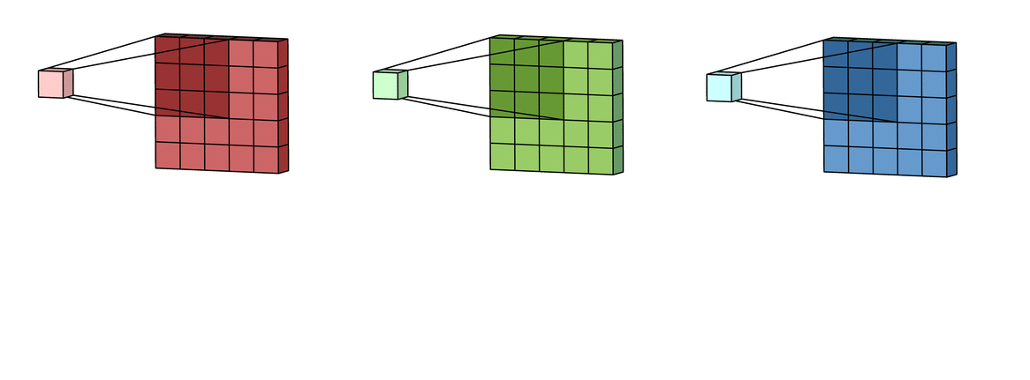



Convolutional Nueral Network
$$y_{1},y_{2},…y_{n}$$
…
…
RGB Input
(128x128x3)
50 filters
(3x3x3)
Tensor
(128x128x50)
$k$ filters
(3x3x50)
Output
(1000 classes)
…

Slide 40

Large dataset
COCO: https://cocodataset.org/#home (80 classes)
ImageNet (1000 classes with 1.3M labeled images)
Common Crawl (~100TB+)

Slide 41


Transfer learning
$$y_{1},y_{2},…y_{80}$$
…
…
…
Input
Convolution layer
Output (80)

Slide 42

Transfer learning
$$y_{1},y_{2},…$$
…
…
…
Input
Convolution layer
Output (24)

Slide 43
Resnet
y
…
…
Input
Residual block
Output

Slide 44
Auto encoder decoder
H₁
H
H₁
H
W₂₁
W₂₁
W₁₁
W₁₁
x₁
H₂
W₂₂
x₁
H₂
W₂₂
W₁₂
W₁₂
x₂
…
x₂
W_{ij}
W_{ij}
H_{k}
H_{k}

Slide 45

CNN Auto-encoder-decoder
Input
Encoder
Bottleneck
Decoder
Output

Slide 46













Generative Adversarial Networks (GANs)
Prediction
Real Images
Discriminator
Real
Fake
Generator
Noise
Fake Images
$$\min_{G}{\max_{D}\left(D,G\right)=\log\left(D\left(x\right)\right)+log⁡(1−D(G(z)))}$$

Slide 47


Natural language processing
Chat-GPT: Chat Generative Pre-trained Transformer
Tokenization and vectorization
Attention

Slide 48


Code faster
Cui, Zheyuan Kevin, et al. "The effects of generative ai on high skilled work: Evidence from three field experiments with software developers." Available at SSRN 4945566 (2024).

Slide 49
Tokenization
“I want pizza”
“我想要披萨”
“ピザが欲しいです”
“Eu quero pizza”
“أريد بيتزا ”
“मुझे पिज़्ज़ा चाहिए”
“Quiero pizza”
“피자가 먹고 싶어요”

Slide 50

… | I | want | pizza | … | spore | …
Total Text Corpus
Embedding | 1 | 2 | 3 | … | n
… | … | … | … | … | …
I | $$e_{i1}$$ | $$e_{i2}$$ | $$e_{i3}$$ | … | $$e_{in}$$
want | $$e_{w1}$$ | $$e_{w2}$$ | $$e_{w3}$$ | … | $$e_{wn}$$
pizza | $$e_{p1}$$ | $$e_{p2}$$ | $$e_{p3}$$ | … | $$e_{pn}$$
… | … | … | … | … | …
spore | $$e_{s1}$$ | $$e_{s2}$$ | $$e_{s3}$$ | … | $$e_{sn}$$
… | … | … | … | … | …
Embedding 1
I
pizza
want
spore
Embedding 2
Embedding 3

Slide 51




… | I | want | pizza | … | spore | …
$$new \vec{w}=old \vec{w}−∇∗LR$$
Positive:
$$\left[I, pizza\right]$$
$$[I, want]$$
…
Negative:
$$\left[I, spore\right]$$
…

Slide 52
Turning words to numbers
Tokenization: https://tiktokenizer.vercel.app/
Vectorization: https://projector.tensorflow.org/
Does not work with math:
https://grok.com/
https://copilot.microsoft.com
https://chatgpt.com/
67544*090766*0.00987*0.9876

Slide 53


Slide 54


Cosine similarity
Vector A and B
Range from -1 to 1 -> not similar to similar
$\cos\left(θ\right)=\frac{A ∙B}{\left|\left|A\right|\right||\left|B\right||}$= $\frac{\sum_{i=1}^{n}{A_{i}B_{i}}}{\sqrt{\sum_{i=1}^{n}{A_{i}^{2}}}\sqrt{\sum_{i=1}^{n}{B_{i}^{2}}}}$

Slide 55


Slide 56


Slide 57


Slide 58
CV and NLP
Deep neural networks: CV->NLP
Transformer: NLP->CV

Slide 59

Matrix review
$$\left[\begin{matrix}a & b \\ c & d\end{matrix}\right]\left[\begin{matrix}e \\ f\end{matrix}\right]=\left[\begin{matrix}a∗e+b∗f \\ c∗e+d∗f\end{matrix}\right]$$
2x2
2x1
2x1
2x1

Slide 60

Attention
Word | Dim 1 | Dim 2 | Dim 3 | Dim 4
I | 0.23 | -0.48 | 0.77 | 0.12
want | -0.61 | 0.35 | -0.10 | 0.56
pizza | 0.44 | 0.89 | -0.33 | -0.21
$$=Q=K=V$$
3x4
$$attention=\left(QK^{T}\right)V$$
3x4
4x3
3x3
3x4
3x4

Slide 61




Probability for each word in the vocabulary
$$attention=\left(QK^{T}\right)V$$
3x4
4x3
3x3
3x4
 | I | want | pizza
I | 0.3154 | 0.2230 | 0.4615
want | 0.0388 | 0.2159 | 0.7453
pizza | 0.2546 | 0.1330 | 0.6124
3x4
$$Q$$
$$K$$
$$V$$
Vaswani, A. (2017). Attention is all you need. Advances in Neural Information Processing Systems.

Slide 62
 | I | want | pizza
I | 0.3154 | 0 | 0
want | 0.0388 | 0.2159 | 0
pizza | 0.2546 | 0.1330 | 0.6124
Word | Dim 1 | Dim 2 | Dim 3 | Dim 4
I | 0.23 | -0.48 | 0.77 | 0.12
want | -0.61 | 0.35 | -0.10 | 0.56
pizza | 0.44 | 0.89 | -0.33 | -0.21
3x3
3x4
$$masked attention=\left(QK^{T}\right)V$$
3x4
4x3
3x3
3x4
3x4

Slide 63

Probability | 0.07 | 0.91 | 0.01 | … | 0.00 | …
Vocabulary | want | from | pizza | … | spore | …
Input window |  |  | Next
I | want | pizza | ____
want | pizza | from | ____
… | … | … | …
Word | Dim 1 | Dim 2 | Dim 3 | Dim 4
I | 0.23 | -0.48 | 0.77 | 0.12
want | -0.61 | 0.35 | -0.10 | 0.56
pizza | 0.44 | 0.89 | -0.33 | -0.21
Radford, A., Narasimhan, K., Salimans, T., & Sutskever, I. (2018). Improving language understanding by generative pre-training.

Slide 64

Perplexity
For each word i, the positive prediction is y_pred
W is the total number of words in the test corpus S
Minimizing perplexity = maximizing probability
$$perplexity\left(S\right)=2^{(−\frac{1}{W}\sum_{i=1}^{n}{\log_{2}⁡(y_{pred,i})) }}$$

Slide 65

BLEU
Candidate: I want pizza
Reference: I want fired rice
$$precision=\frac{\# overlapping words}{\# candidate words}=\frac{2}{3}$$
$$recall=\frac{\# overlapping words}{\# reference words}=\frac{2}{4}$$

Slide 66

N-gram BLEU
2-gram BLEU
Candidate: [“I want”, “want pizza”]
Reference: [ “I want”, “want fired”, “fried rice”]
3-gram BELU
$$BLEU=\prod_{i=1}^{N}{p_{i}}$$

Slide 67
GPT 3
Parameters 175 B
Dataset 45T
96 attention heads
2048 token size
Learn from their chief scientist: https://www.youtube.com/watch?v=kCc8FmEb1nY

Slide 68


